Slide 1





PassGuard
A Desktop Password Manager
Senior Group 57
Dr.Mohammed Saleh
Youssef Aly
Essa Ahmed
Khalifa Yousuf
Mohamed Dhia

Slide 2
Table of Content
01
04
System Architecture
High Level System Architecture
Alternative Solutions and Tradeoffs
Introduction and Motivation
Problem Statement
Project Objectives & Benefits
Market Research
02
Background & Related Work
Related Work
05
Detailed Design
Structural Model
Behavioral Model
Database Design
User Interface Design
03
Requirements Analysis
Applying the software development process
Functional Requirements
Non-Functional Requirements
06
Hardware/Software Used
Software Comparison
Challenging Issues and Solutions
07
PoC Demo & Video

Slide 3
Introduction and Motivation
Problem Statement
Project Objectives & Benefits
Market Research
01
Introduction and Motivation

Slide 4

Problem Statement
Framing The Issue
Issue
User Pain Points
Technical Challenges
Skyrocket of Data breaches
No Obvious Solution
Involves Multiple Disciplines
Conflicting Technical Issues Tradeoffs
User Education
User Trust
User Experience
Adoption and Advertising
Robust Encryption
Password Recovery and Backup
Intuitive UI
Password Analysis

Slide 5







Key Objectives
Easy-To-Use UI
Password Generation Functionality
Suitable for wide range of users.
Utilizing algorithms that ensures strong, unique passwords.
Implement MFA
Automated Security Scanning Tools
Enhances security and user confidence in our app.
Design alert mechanisms that informs user of their password strengths and recommend solutions.
Secure Encryption
Compliance with privacy Regulations
Password and Data Storage that meets industry best practices.
Ensure data protection and the continuous evaluation and monitoring of best practices throughout the project's lifecycle.

Slide 6







Expected Benefits
Individuals
Organizations
Enhance Digital Security
Reduce the risk of data breaches.
Promote Convenience
Boost Productivity
Promote Efficiency
Enhance Security
Society
Global
Enhance Online Safety
Minimize Identity Theft
Promote Responsible Online Habits
Thriving Cybersecurity Industry.
Boosting Competitiveness

Slide 7
Market Analysis
Know the customer
Users characteristics
Application features
Business plan
Market size
Security behavior
Security knowledge
Obstacles
Simple
Secure
Transparent !
Innovative
Customizable
Free ! (general users)
Payable (business)
Strong marketing
Institutional collaboration
In-app advertisement ?

Slide 8
Background And Related Work
Related Work
User Reviews About Related Work
02
Background And Related Work

Slide 9


Related Work
Comparison Table
NORDPASS
BITWARDEN
ROBOFROM
KEEPASS
PASSGUARD
Unlimited Storage
Subscription Free
Encryption In Transit
Import/Export
User-Friendly
Cloud Storage Independent

Slide 10
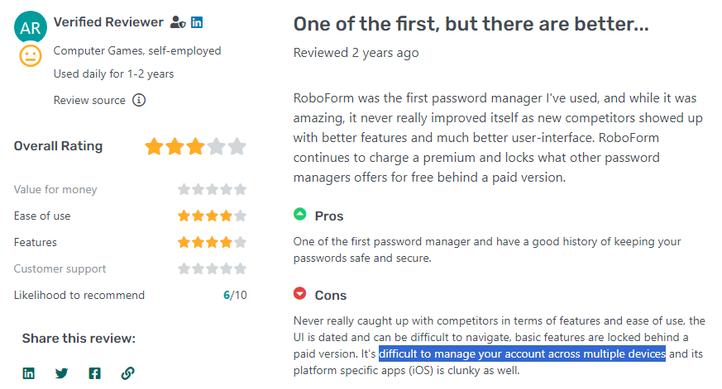
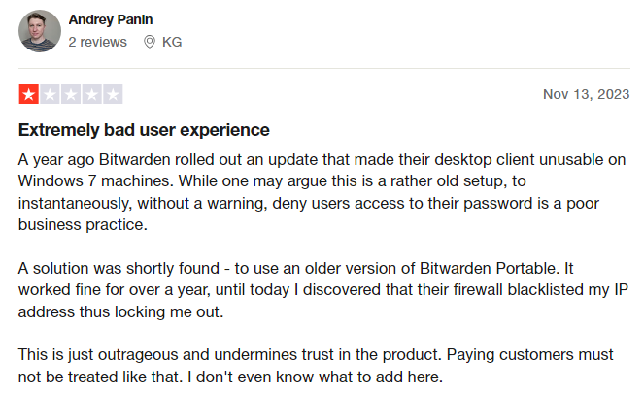
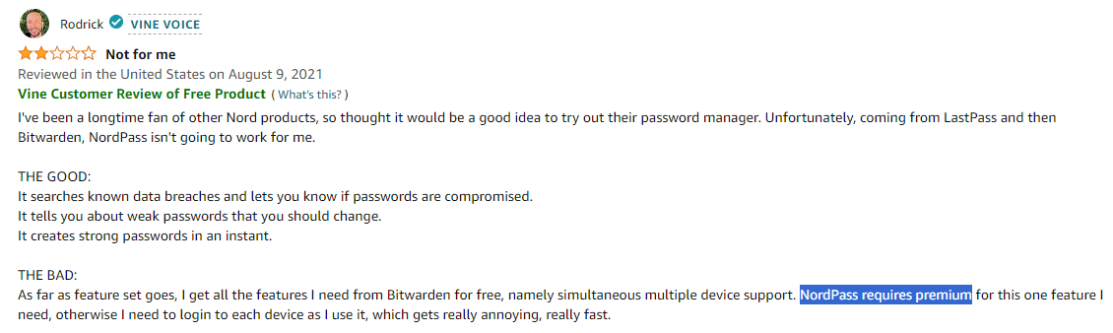
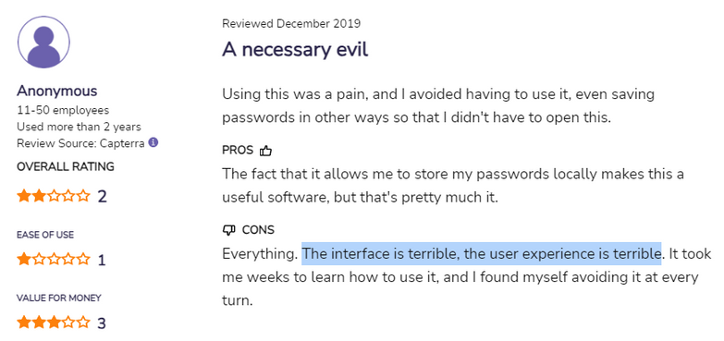
User Reviews Ab﻿out Related Work
RoboForm
BitWarden
NordPass
KeePass

Slide 11
Requirements Analysis
Applying Software Development Process
Functional Requirements
Non-Functional Requirements
03
Requirements Analysis

Slide 12
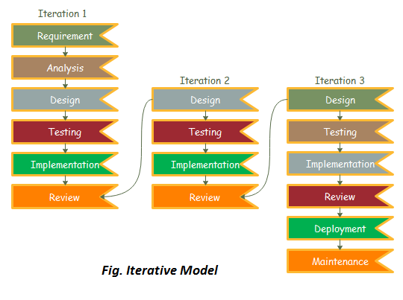
Applying the Software Development Process

Slide 13
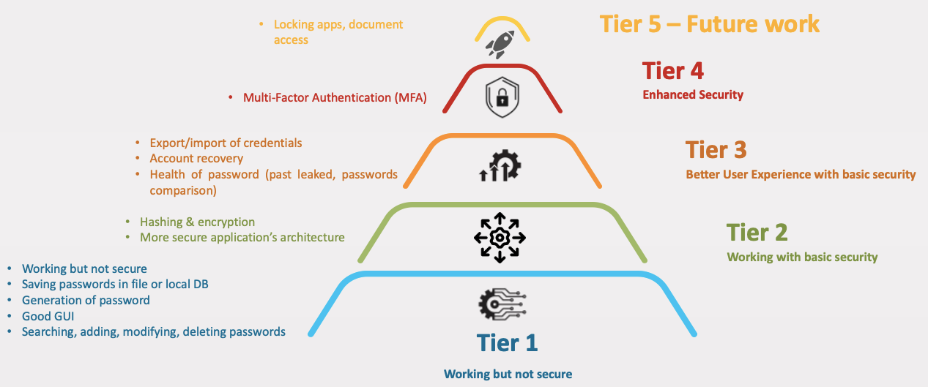
Applying the Software Development Process
iers pyramid5 tier

Slide 14
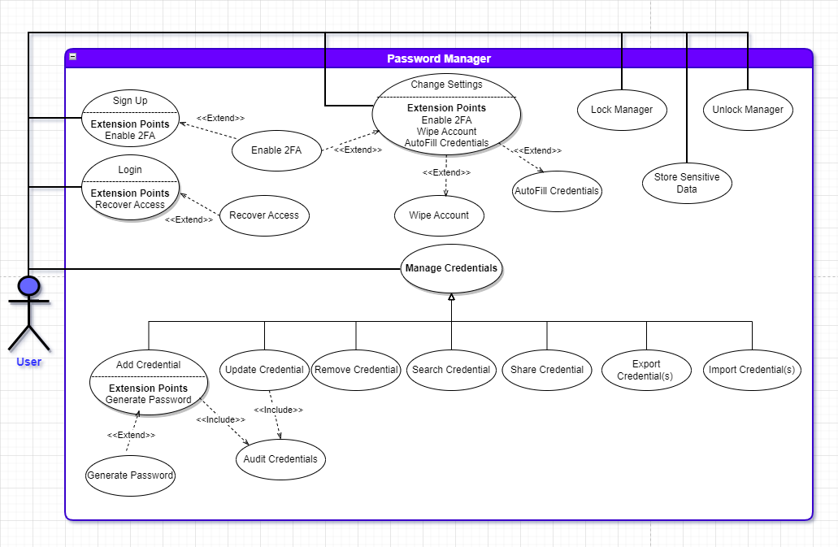
Functional Requirements

Slide 15



Non-Func﻿tional Requirements
Security
Performance
Reliability
The system must implement robust security measures to uphold the CIA triad, safeguarding users' personal assets
The application must ensure a fast response time
The system will incorporate appropriate failover mechanisms and implement backup procedures to mitigate the impact of disasters

Slide 16
System Architecture
High Level System Architecture
Alternative Solutions and Tradeoffs
04
System Architecture

Slide 17
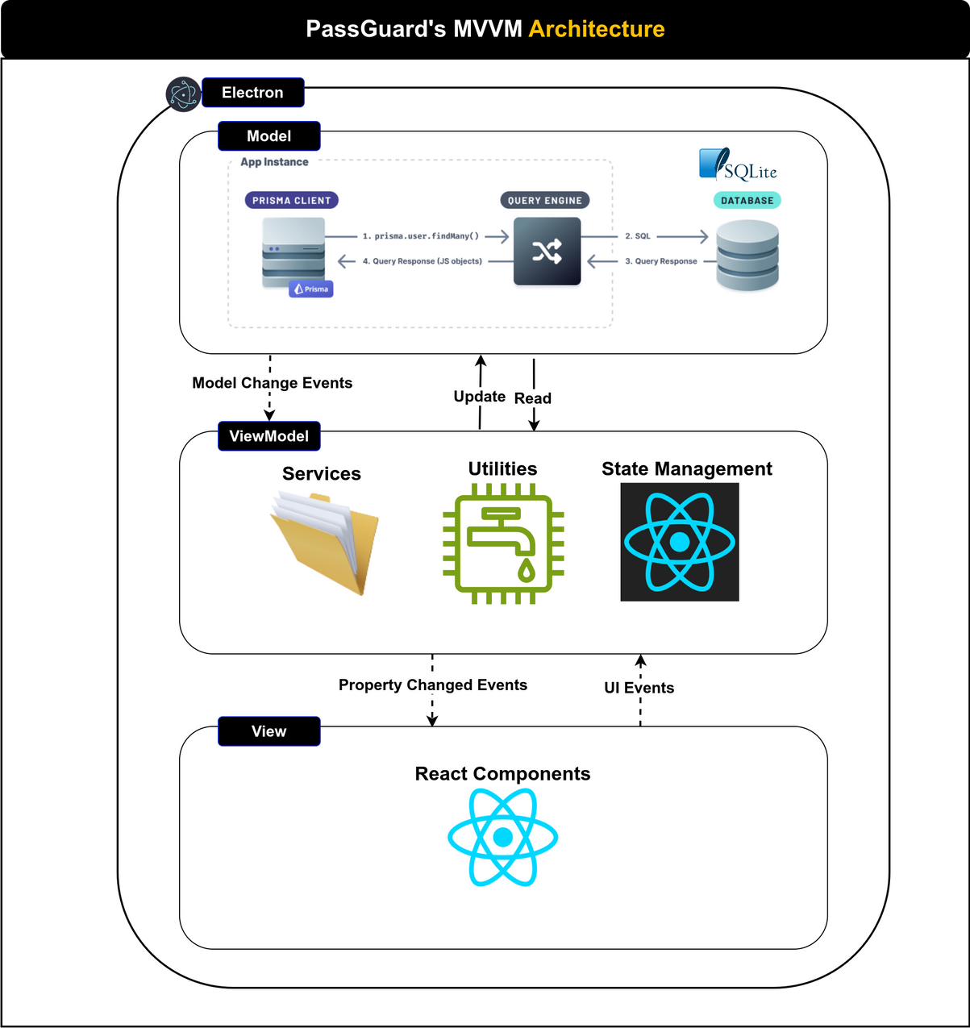
High Level Architecture Diagram

Slide 18






Alternative Solution And Tradeoffs

Slide 19
Detailed Design
Structural Model
Behavioral Model
Database Design
User Interface Design
Design Patterns
05
Detailed Design

Slide 20
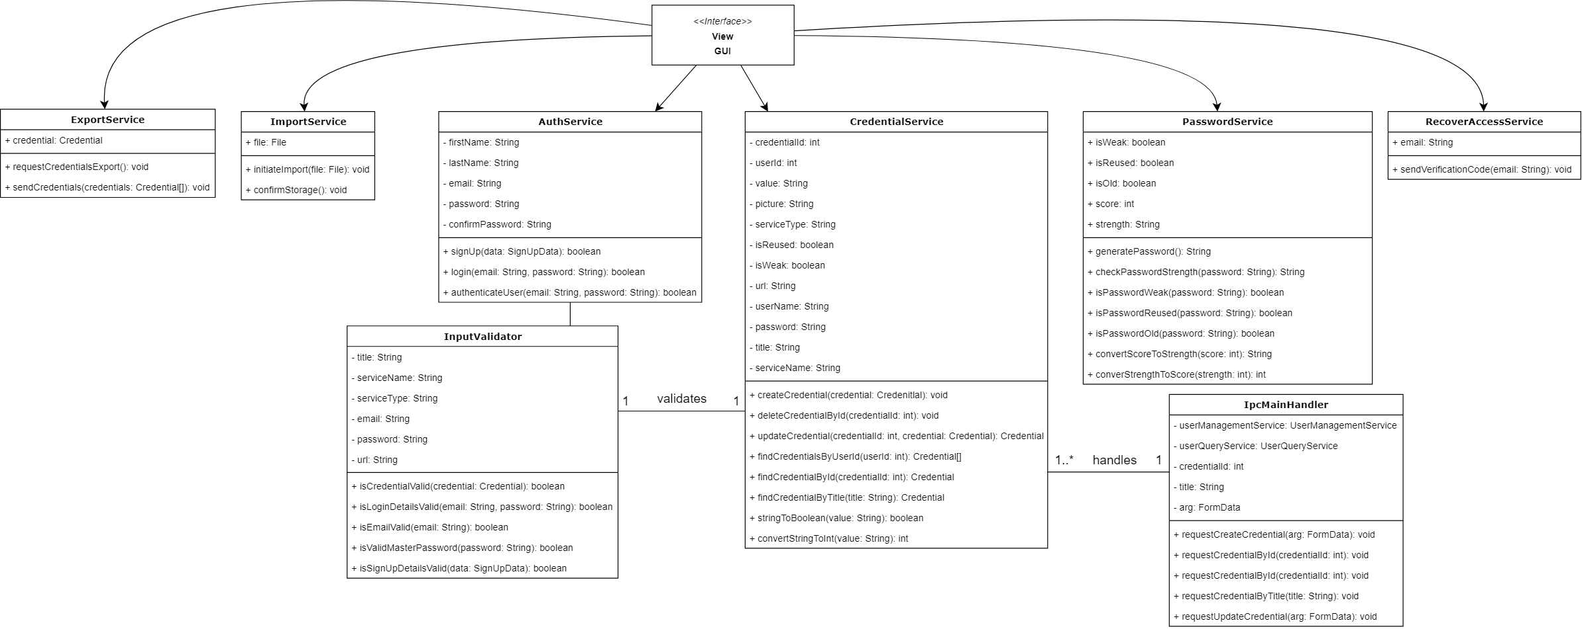
UML Class Diagram

Slide 21
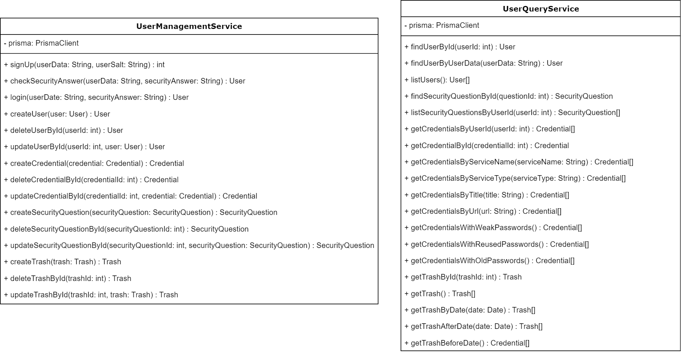
UML Repository Design Diagram

Slide 22
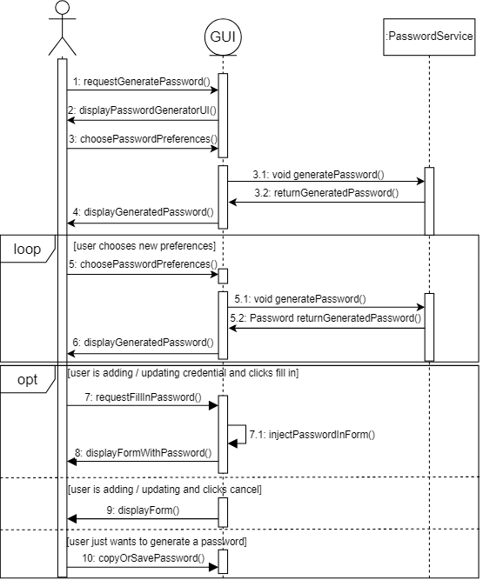
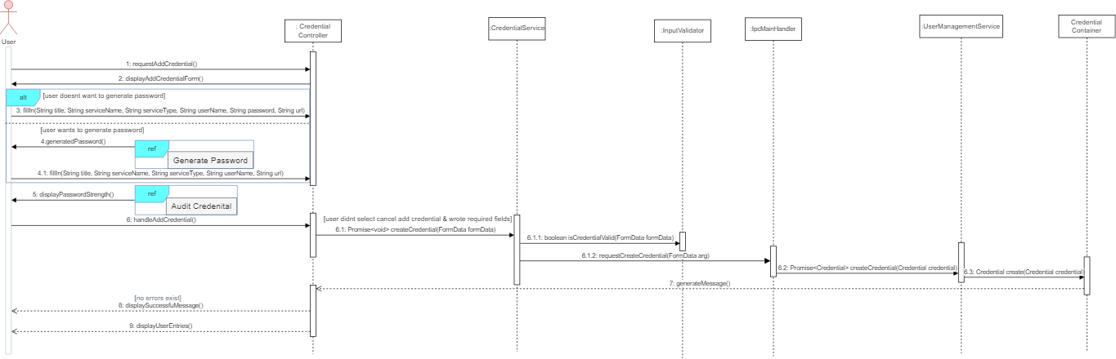
Add Credential & ﻿Generate Password DSD

Slide 23
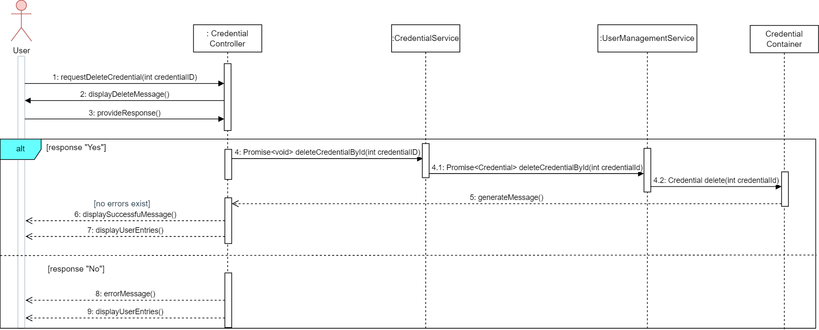
Remove Credential DSD

Slide 24
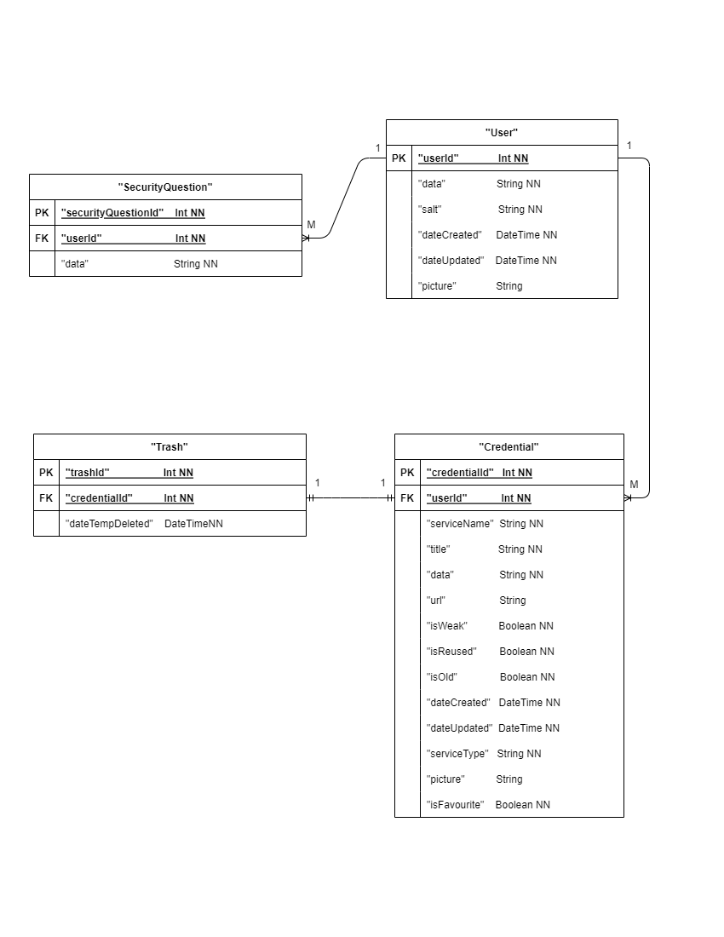
Database Design

Slide 25
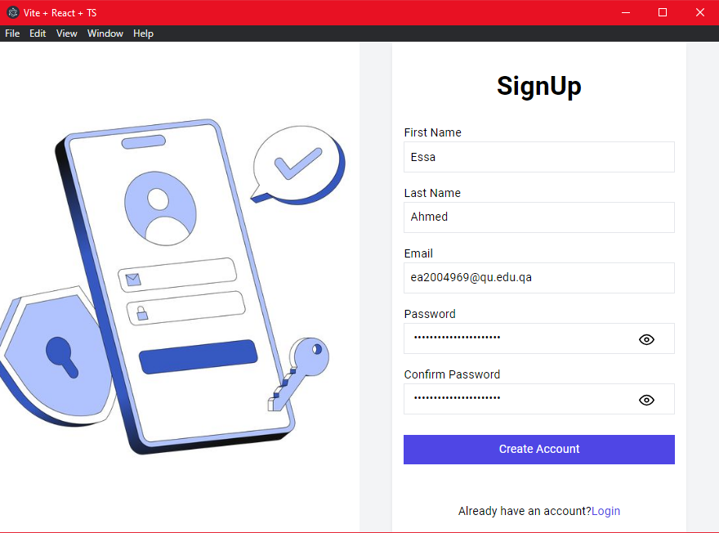
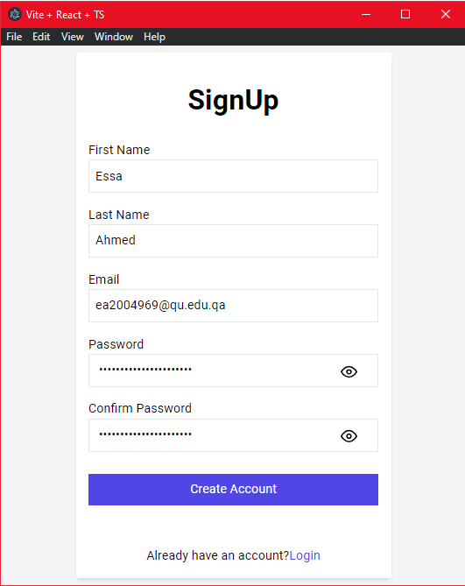
Sign Up Design
Sign Up Wide Screen
Sign Up Small Screen

Slide 26
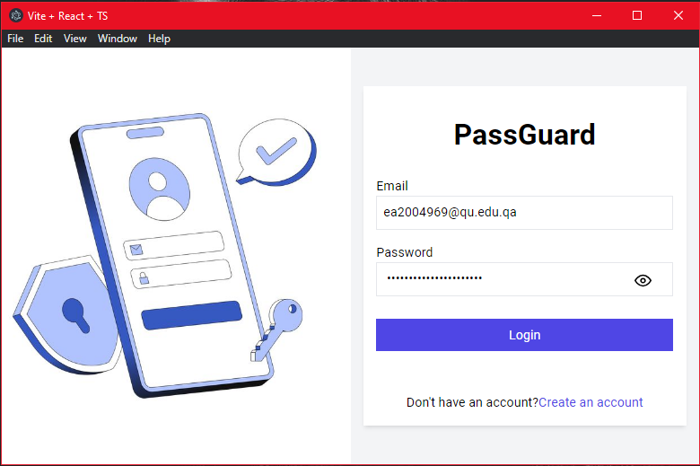
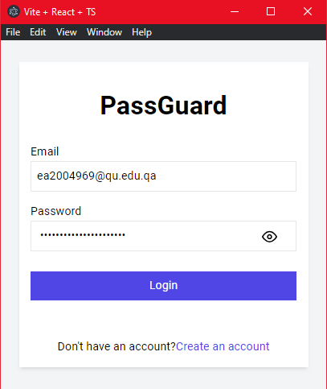
Login Design
Login Wide Screen
Login Small Screen

Slide 27
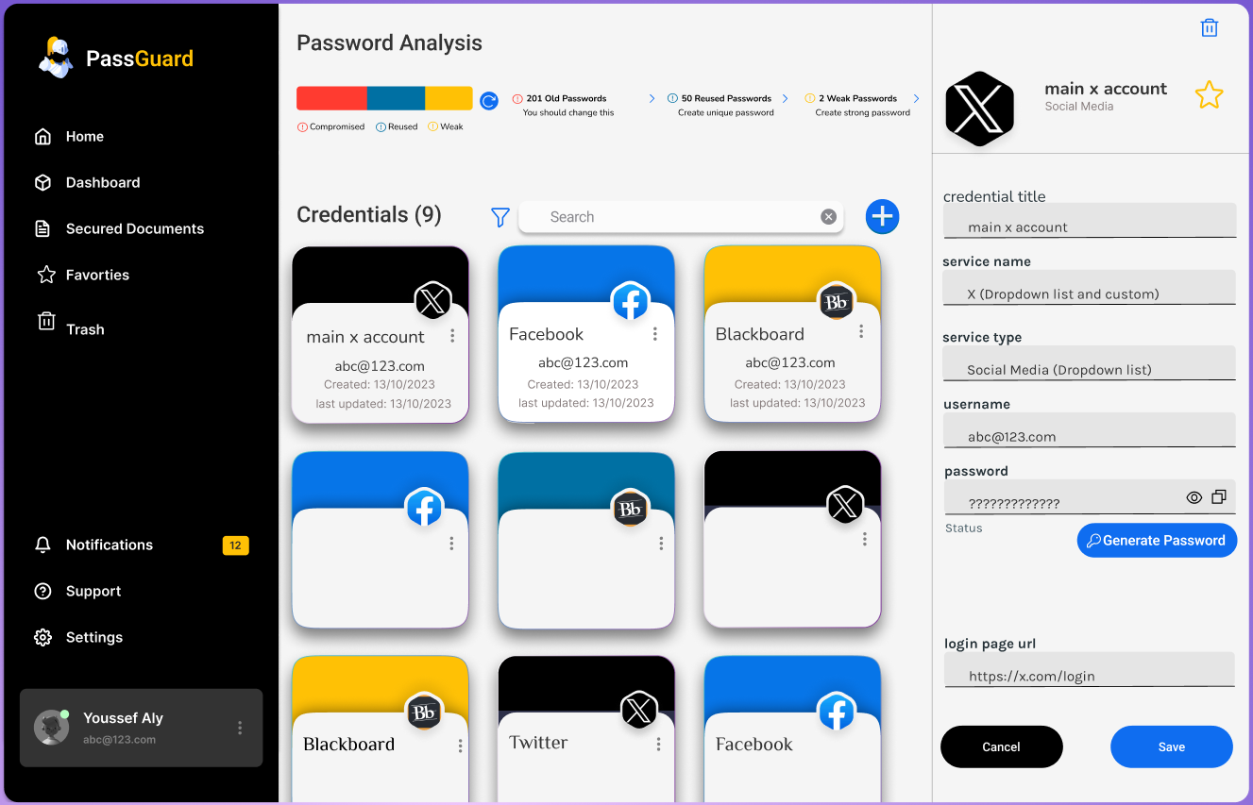
User Interface Design

Slide 28
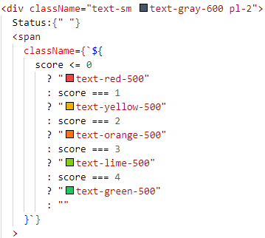
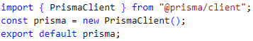
Design Patterns
Conditional Rendering in React
Singleton
Hook in React
Used to allow us to create distinct components based on needs & render the ones that are required.
Used to let us ensure that a class has only one instance while providing global access point to the instance
Used to make it much clearer to separate the logic of our components into smaller pieces

Slide 29
Hardware / Software Used
Software Comparison
Challenging Issues And Solutions
06
Hardware / Software Used

Slide 30










Software Comparison
Nw.js and electron are technologies to create desktop apps
.JS
Angular and React are front-end development frameworks known for their component-based architecture
Webpack and Vite are both modern front-end build tools
PostgreSQL and SQLite are both powerful database management systems
TypeScript is superset of Javascript

Slide 31







Other Softwares Used
Prisma
Tailwind css
Visual Studio
GitHub
Draw.io
Ms Project
Jest

Slide 32
Challenges and Solutions
Challenges
Solutions
Creating a Unique User interface
Selecting right tools and technologies
Dealing with new tools
Linking Front-end with Back-end
Studied design principles that most users like
Read documents, online resources and watching tutorials to master new tools
Trial and errors

Slide 33

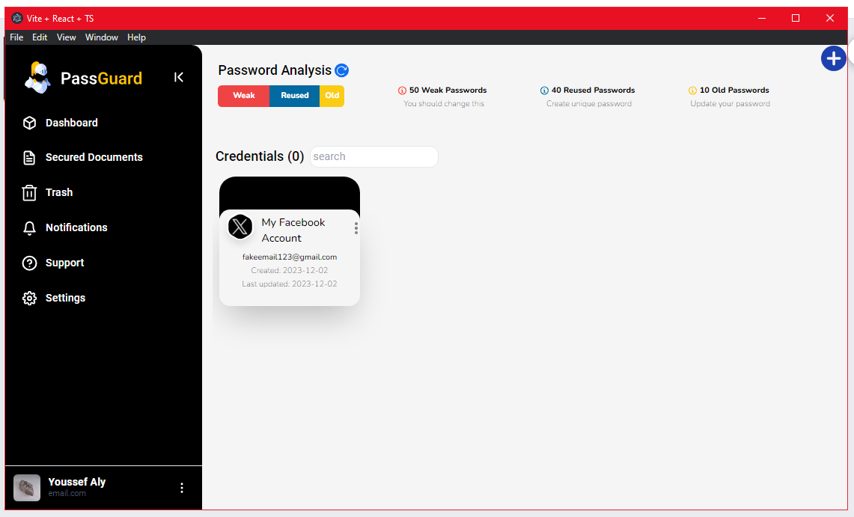
06 PoC Demo And Video

Slide 34
Thank You For Listening!
Do you have any question ?
07
Conclusion

